Slide 1
Women’s Center & Shelter of Greater Pittsburgh IPV Homeless Provider Program
Presented by Matthew Grayson - Ipv homeless provider supervisor

Slide 2
Who Am I?
Matthew Grayson
IPV Homeless Provider Program Supervisor
Help train homeless provider staff about IPV/DV
To help screen/intake process
Frontline staff safety
Resident safety
Share WCS Resources

Slide 3
Warning!!!
The topics discussed today are heavy and emotionally impactful. If at any time you feel the information is too much for you, please feel free to excuse yourself to take some time.

Slide 4
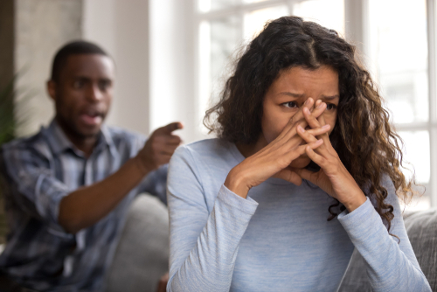
What is Domestic Violence (DV)? Intimate Partner Violence (IPV)
Partner violence is a PATTERN of coercive behavior used by one person to GAIN POWER AND CONTROL over another in an intimate relationship.
Domestic Violence- Violence committed by someone in the victim’s domestic circle. ( Partners, ex-partners, immediate family members, other relatives and friends. (there is a close relationship between the offender and victim.)
Notes:
Distinction b/t IPV and DV: IPV is between intimate partners and DV can be anyone living with the survivor
What is Battering?
Establishment of CONTROL AND FEAR in a relationship through violence and other forms of abuse.
The person uses acts of violence and a series of behaviors, including intimidation, threats, isolation, etc. to control the other person.
It may not happen often, but it remains as a hidden and constant terrorizing factor.

Slide 5
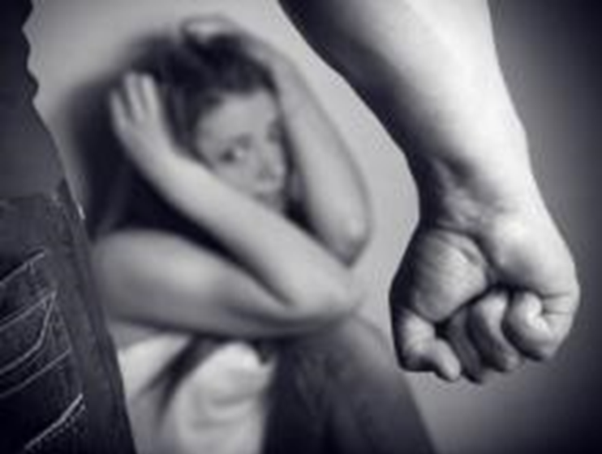
Domestic Violence Stats:
On average, nearly 20 people per minute are physically abused by an intimate partner in the United States. During one year, this equates to more than 10 million women and men.
About 1 in 4 women and nearly 1 in 10 men have experienced sexual violence, physical violence, and/or stalking by an intimate partner during their lifetime and reported some form of IPV-related impact.
https://www.cdc.gov/violenceprevention/intimatepartnerviolence/fastfact.html
Notes:
Think about this… we’ll be together for 4 hours today. 4*60*20=4800. That means by the end of this presentation, 4800 people will experience physical abuse by an intimate partner.

Slide 6
TYPES OF ABUSE
EMOTIONAL
Manipulating with lies
Breaking possessions
Making all decisions
PHYSICAL
Punching
Hitting with objects
Choking/Strangulation
FINANCIAL
Controlling all finances
Abusing credit cards
PSYCHOLOGICAL
Mind games
Silent treatment
Altering your perception
Stalking
ISOLATION
Keeping partner from family or friends
Restricted freedom
VERBAL
Name calling
Public humiliation
Constant criticizing
SEXUAL
Unwanted touching
Forced sex
Multiple partners/objects
INTIMIDATION
Using looks, actions and loud voice to control
Threats of physical harm
Stalking
Unwanted texts, calls
Unwanted flowers, gifts, cards
Monitoring behavior through mutual friends

Slide 7
TYPES OF ABUSE cont.
Spiritual
Isolates from religious community
Interfering with spiritual practices
Criticizing beliefs, practices, traditions
Using faith/beliefs as a means of manipulation
Insisting they follow abuser’s religious practices
Systems
(Using social systems to control partner through ACTIONS or THREATS of action)
Getting unjustified PFA
Using mental health diagnosis
Reporting to CYF, DPW, etc.
Threatening deportation
Taking passport
Custody of children

Slide 8
Physical Abuse
Examples include:
Hitting
Punching
Hair pulling
Biting
Shoving
Kicking
Choking
Scratching
WC&S 24/7 Hotline: 412-687-8005 | Textline: 412-744-8445 (9 am-9 pm, daily)

Slide 9
Verbal Abuse
Examples include:
Threats
Yelling
Cursing
Put downs
Criticizing
Belittling
Calling names
Degrading
Insulting
WC&S 24/7 Hotline: 412-687-8005 | Textline: 412-744-8445 (9 am-9 pm, daily)

Slide 10
Mental/Emotional Abuse
Examples include:
Mind games
Put downs
Accusations
Blaming
Humiliation
Demanding attention
Name calling
Bullying
Lying
Gaslighting
WC&S 24/7 Hotline: 412-687-8005 | Textline: 412-744-8445 (9 am-9 pm, daily)

Slide 11
Mental/Emotional Abuse
Examples include:
Threatening a partner or harming their sense of self-worth
Labelling as stupid
Intimidating
Threatening suicide
Isolation
Threatening to “out”
Using the wrong pronouns
Denying partner’s gender identity
Using citizenship status to manipulate
Throwing things
Punching walls
WC&S 24/7 Hotline: 412-687-8005 | Textline: 412-744-8445 (9 am-9 pm, daily)

Slide 12
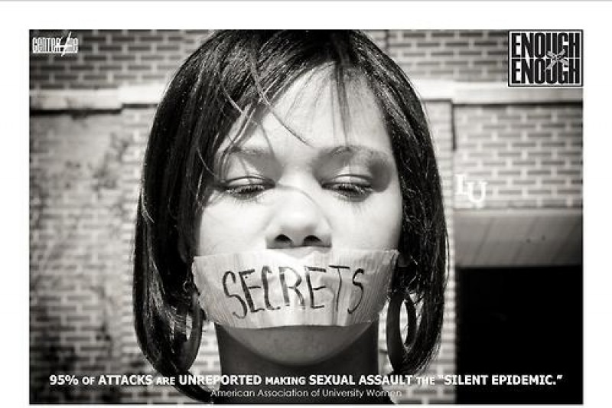
Sexual Abuse Coercing or forcing a partner to engage in a sex act when they do not or cannot consent
Examples include:
Rape
Unwanted touching
Cheating
Manipulating to have sex
Minimizing feelings about sex
Criticizing sexually
Degrading
WC&S 24/7 Hotline: 412-687-8005 | Textline: 412-744-8445 (9 am-9 pm, daily)
Notes:
What is consent?
Consent is a clear, enthusiastic yes. Consent is always needed before touching another person’s body, whether sexual or not. You can give consent of you are informed (you know what you’re consenting to); willing (you can choose whether or not you want to without coercion and there’s no pressure); coherent (in a state that allow you to make a decision, not asleep or incapacitated); clear (you need to be able to give a clear enthusiastic yes)

Slide 13
Digital Abuse
Examples include:
Excessive texting and calling
“Hacking” into social media accounts or demanding passwords/access
Using GPS trackers to stalk
Catfishing
Publishing nude photos
Sexting
Doxxing
WC&S 24/7 Hotline: 412-687-8005 | Textline: 412-744-8445 (9 am-9 pm, daily)

Slide 14
Stalking
Examples:
Unwanted texts, calls
Unwanted flowers, gifts, cards
Monitoring behavior through mutual friends
Showing up places (work, school, home) when it was unwanted
Leaving strange or potentially threatening items for victim to find
Doing things to scare victim and let them know the perpetrator had been there
WC&S 24/7 Hotline: 412-687-8005 | Textline: 412-744-8445 (9 am-9 pm, daily)
Notes:
Stalking is a tactic that can fall under any of these types of abuse to maintain power and control. Examples: unwanted phone calls, texts, DMs, social media comments and posts, unwanted cards letters, flowers, presents, showing up places (work, school, home) when it was unwanted, leaving strange or potentially threatening items for the victim to find, doing thing to scare the victim or let them know the perpetrator had been there.
About 1 in 5 female victims and 1 in 14 male victims has experienced stalking between the ages of 1 and 17.

Slide 15
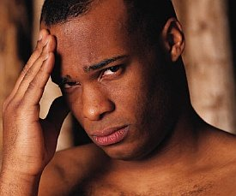
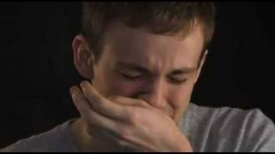
Cycle of Violence
Tension Building
Abusive Episode
Honeymoon Phase
Poor communication
Frustration
Hitting
Isolating
Yelling
Guilt
Remorse
Apologies and Promises
WC&S 24/7 Hotline: 412-687-8005 | Textline: 412-744-8445 (9 am-9 pm, daily)
Notes:
Once violence occurs in a relationship, without intervention, it will increase in regard to frequency and severity.

Slide 16
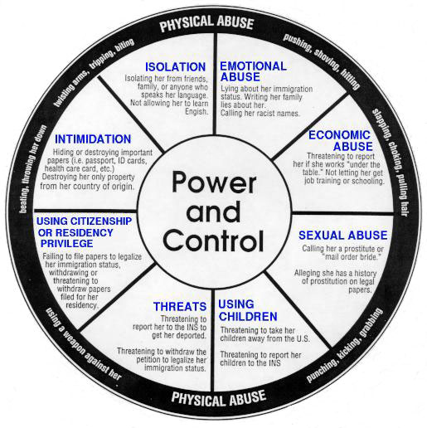
Power and Control Wheel

Slide 17
Why do some victims stay in an abusive relationship?
Fear
Love
No support system
Embarrassed
Economics
Religious or cultural beliefs
Children
Low self-esteem
Nowhere to go
Threats on their life or their kids’ lives if they leave
Fear of being alone
Protect image of ‘perfect’ relationship
They think the abuser will change
They think they deserve it
They want to end the abuse not the relationship
They see violence as normal
They think it’s their fault
They feel the relationship is their responsibility and they have to fix it
The abuser has a loving side
They are unaware of their resource
Legal help seems too expensive or too complicated

Slide 18
DID YOU KNOW….
Leaving a violent relationship is the most dangerous time for a victim.
On average women will leave their abusive partners 7 times before permanently leaving the relationship.
75% of DV related homicides occur when they are leaving or have just left!

Slide 19
Domestic Violence
FACTS-
85% of DV victims are women
Child abuse is more likely to occur by 75% of intimate partner violence families.
Pregnancy is a risk factor for battering.
Several studies indicate a range of incidence from 8% to 15% of pregnant women in public and private clinics to as much as 24% to 26%.
One study showed that 30% of women presenting with injuries in an Emergency Department were identified as having injuries caused by battering.

Slide 20
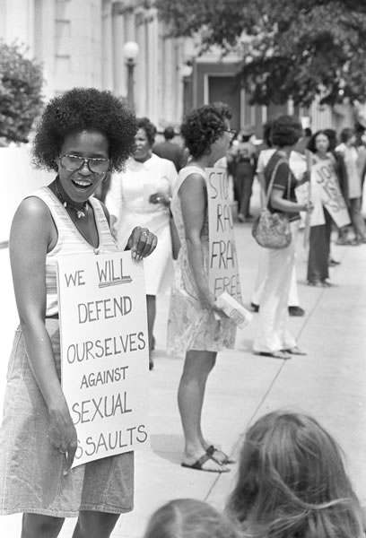
How IPV Affects African American Women
More than 4 out of 10 Black women experience physical violence from an intimate partner during their lifetimes.
Black women also experience significantly higher rates of psychological abuse—including humiliation, insults, name-calling, and coercive control—than do women overall.
Sexual violence affects Black women at high rates. More than 20 percent of Black women are raped during their lifetimes—a higher share than among women overall.
Black women face a particularly high risk of being killed at the hands of a man. A 2015 Violence Policy Center study finds that Black women were two and a half times more likely to be murdered by men than their White counterparts. More than nine in ten Black female victims knew their killers.

Slide 21
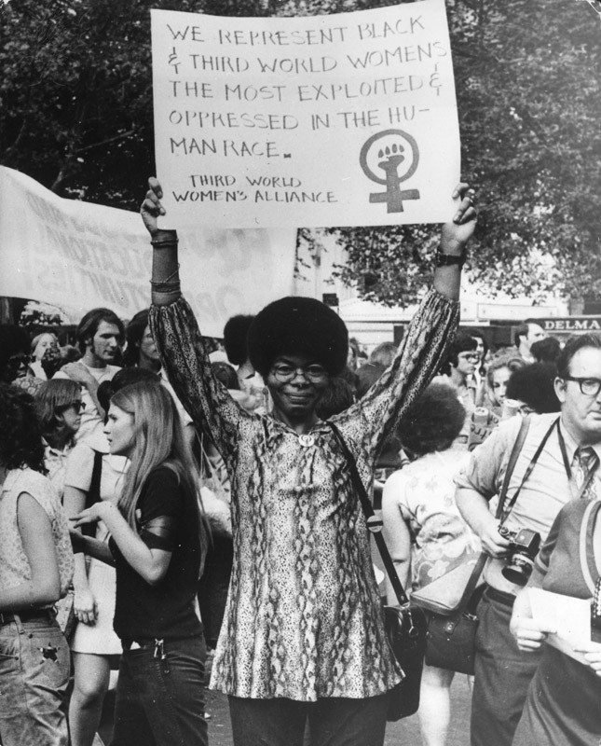
How IPV Affects African American Women
Nearly all —92% — of these killings were intra-racial, which means that they were committed by a Black man against a Black woman.
With statistics like these, the Black Women’s Health Project determined that domestic violence is the number one health issue facing Black women.
And in Black communities, the problem is particularly severe, with abuse being the leading cause of injury among Black women ages 15 to 44.

Slide 22
TDV and Identities
Among high school students in 2017 who dated or went out with someone in the past year, 8% experienced physical dating violence.
However, experiences varied for members of different groups:
9.1% of female students experienced physical dating violence
6.5% of male students experienced physical dating violence
10.2% of Black students experienced physical dating violence
7% of white students experienced physical dating violence
7.6% of Hispanic students experienced physical dating violence
17.2% of lesbian, gay, or bisexual+ students experienced physical dating violence
6.4% of heterosexual students experienced physical dating violence
https://timesupfoundation.org/black-survivors-and-sexual-trauma/
WC&S 24/7 Hotline: 412-687-8005 | Textline: 412-744-8445 (9 am-9 pm, daily)
Notes:
Does anything surprise you about these statistics?
This list is by no means comprehensive. Trans and nonbinary people disproportionately experience violence in their daily lives. Other racial and ethnic groups may experience DV differently. This study also did not explore other confounding factors of DV, such as religious and cultural beliefs.
Just because some groups are more likely to experience DV, it doesn’t mean that there is something inherently different about those groups.
It is important to remember that identities and experiences are intersecting and overlapping, which means that nobody’s life experience is the same and each person’s identities impacts their life in a unique way. Abuse is a learned behavior and is a choice. We can achieve equality and reduce these numbers by providing the appropriate education and support to communities disproportionately, such as racial and sexual minorities, affected by abuse.
LGBTQ communities face additional challenges. Isolation is compounded by being a member of the LGBTQ community. Silence about partner violence within the LGBTQ community further isolates survivors and gives more control to abusers. Abusers may: threaten to out their partner; portray the violence as mutual; tell their partner that violence is normal in LGBTQ relationships; use HIV/AIDS status to maintain power and control

Slide 23
Domestic Violence and Veterans
Studies have shown that the rate of domestic violence in military families is 2 to 5 times higher than civilian families, with estimates ranging from 22% to 58% depending on the sample population and data collection methodologies used.

Slide 24
Domestic Violence and Veterans
According to the US Department of Defense, in 2020 there were nearly 22,000 reports of domestic violence involving military personnel. This number has been steadily increasing over the years with an estimated 25% of all military couples experiencing domestic violence within their lifetime. In 2018 alone, reported cases grew by 6.6%.
Factors that contribute to higher rates of domestic violence in military families include frequent deployments and separations, high stress levels, PTSD and other mental health issues, exposure to violence, and a culture of secrecy and loyalty.

Slide 25
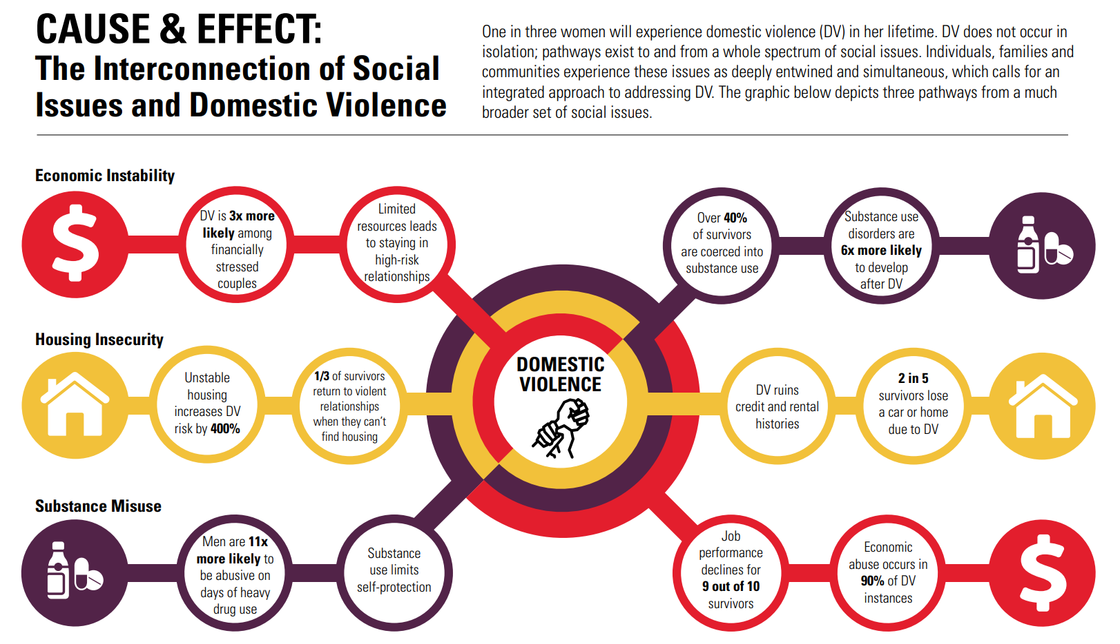
IPV and Other Social Factors
Giron N, Cantor J, Bateman C. Widening the Lens: The Bi-directional Pathways between Domestic Violence and Social Factors. 2018. https://publications.jsi.com/JSIInternet/Inc/Common/_download_pub.cfm?id=22002&lid=3
Notes:
"This graphic shows that IPV is connected with many other social factors, including economic instability, housing insecurity, and substance misuse. I will highlight a few of these intersections: -Limited resources make it difficult for survivors to leave high-risk relationships...and economic abuse occurs in 90% of DV instances -1/3 of survivors return to violent relationships when they cannot find housing...and 2 in 5 survivors lose a car or home due to DV -Men are 11x more likely to use abuse on days of heavy drug use (NOTE: substance use does not cause abuse)…. And over 40% of survivors are coerced into substance use. Hopefully you can see how these social factors are interconnected with one another and with IPV, and how they exacerbate one another."

Slide 26
Warning Signs of an Abusive Relationship
Excessive jealousy
Isolating from friends and family
Explosive temper
Possessiveness/makes all the decisions
Controls partner’s time, clothing, social life, etc.
Criticizes and puts down partner
Witnessed domestic violence at home
Jekyll-Hyde personality
Belief in traditional male/female roles/stereotypes
WC&S 24/7 Hotline: 412-687-8005 | Textline: 412-744-8445 (9 am-9 pm, daily)
Notes:
How do you think you can notice when a relationship is abusive? Or when someone is being abusive?
Have students list examples from personal experience, or from what they saw in the video.
Female/male stereotypes: belief that the woman or man has to hold certain roles in the relationship:
the woman cooks and cleans while the man goes to work; expectation that the male pays for the dates; males should make the final decisions
This can also impact TLGBQ+ relationships (manipulating the partner to think that abuse is reciprocal; denying gender identity of partner)
Witnessing DV at home: YOU CAN BREAK THE CYCLE!
Jekyll-Hyde—a split personality; modern example: the Hulk

Slide 27
Signs and Signals of Dating Victimization
Sudden changes in mood or personality
Bruises, scratches
Avoids eye contact
Using drugs or alcohol
Stops school activities
Anxiety, depression
Avoiding friends or other social events
Afraid of partner
Changes in physical appearance
WC&S 24/7 Hotline: 412-687-8005 | Textline: 412-744-8445 (9 am-9 pm, daily)
Notes:
How do you think you could recognize when someone you know is experiencing violence or victimization?

Slide 28
Resources
DV Hotlines
Safety Plans
Shelter
Court Accompaniment
Counseling
Children’s Services
LGBTQIA+
Hugh Lane Foundation
Central Outreach
Allies for Health and Wellbeing
PFA’s
Current, former relationship
Share biological parents, parenthood, children
Persons related by blood, marriage
Have a child

Slide 29
WCS SERVICES
Hotline
Shelter
WELLNESS Center
Volunteer Program
LGBTQIA+
Medical Advocacy
Legal Advocacy/CLP
RIL Team
Children’s Center
MENS BIP

Slide 30
WE’RE HERE FOR YOU…
24 Hr. Hotline
412-687-8005
Text 9 to 5
412-744-8445
Legal M-F 8-4
412-355-7400
BrightSky App
wcspittsburgh.org

Slide 31
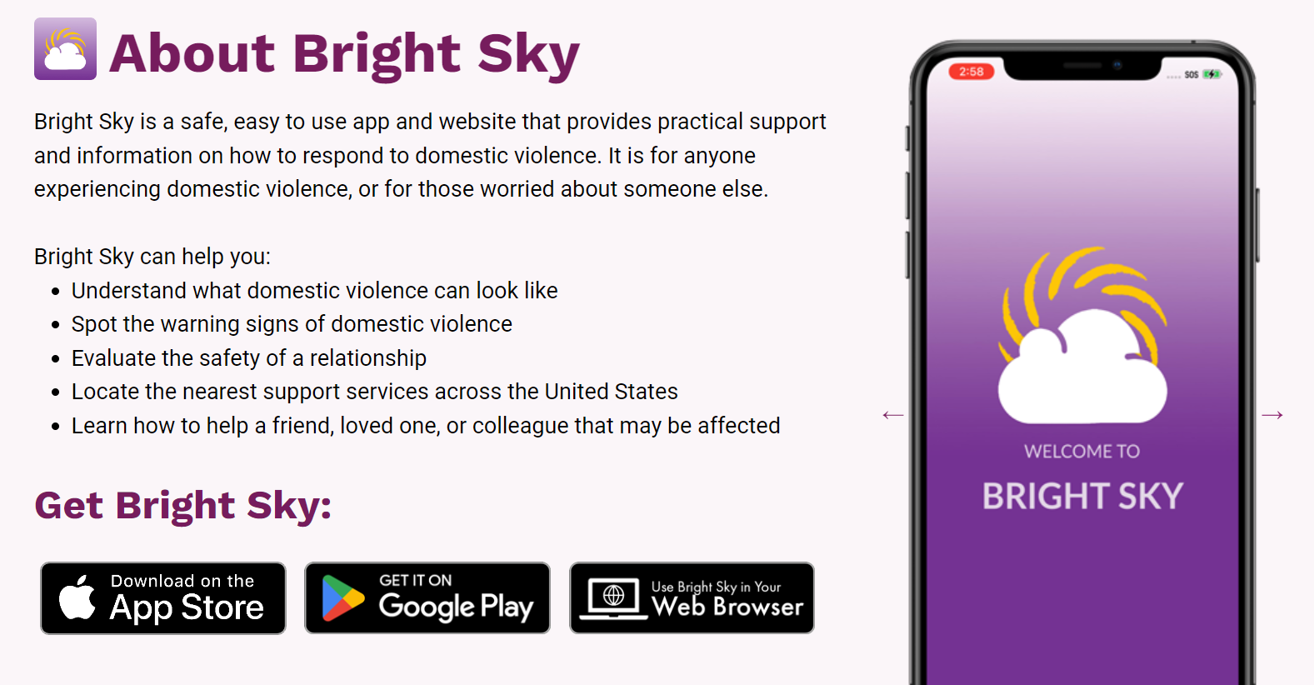
BRIGHTSKY APP
https://wcspittsburgh.org/bright-sky/#AppHelp

